Slide 1

Outline of presentation
Message Passing : IPC
OSI Model and Middleware
RPC
RMI
Message Communication Models
Group Communication
MOM
Stream Oriented Communication

Slide 2
Desirable Features of a Good Message Passing System
Simplicity
Uniform Semantics
Efficiency
Reliability
Correctness
Flexibility
Security
Portability

Slide 3
Issues in IPC by Message Passing
Address
Sequence No.
Structure information
Synchronization
Buffering

Slide 4
Outline of presentation
Message Passing : IPC
OSI Model and Middleware
RPC
RMI
Message Communication Models
Group Communication
MOM
Stream Oriented Communication

Slide 5
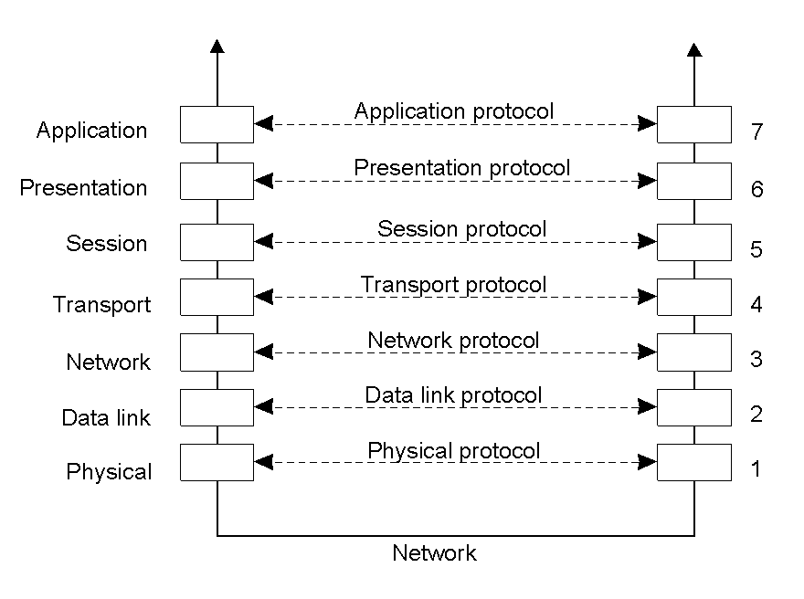
Layered Protocols (1)
Layers, interfaces, and protocols in the OSI model.
2-1
any port
agreed port
socket
socket
message
client
server
other ports
Internet address = 138.37.94.248
Internet address = 138.37.88.249

Slide 6
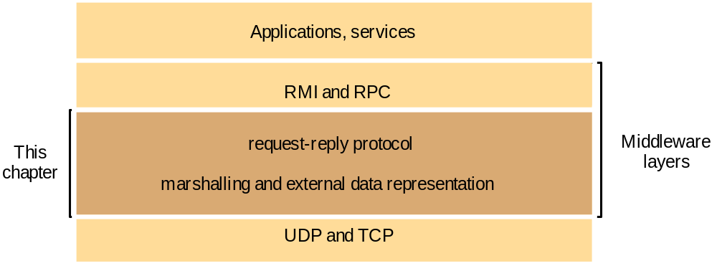
Middleware layers

Slide 7
Outline of presentation
Message Passing : IPC
OSI Model and Middleware
RPC
RMI
Message Communication Models
Group Communication
MOM
Stream Oriented Communication

Slide 8
• In Distributed systems: the callee may be on a different system –Remote Procedure Call (RPC) –NO EXPLICIT MESSAGE PASSING
•Goal: Make RPC look like local procedure call
Parameter passing
Binding
Reliability/How to handle failures –
messages losses –client crash –server crash
Performance and implementation issues
Exception handling
Interface definition

Slide 9
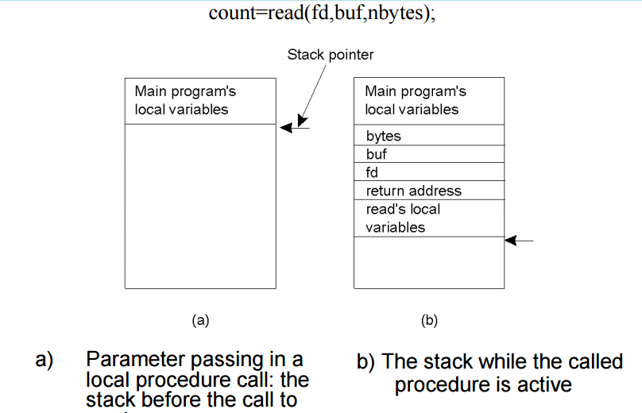
Conventional Procedure call

Slide 10
Observations
•Parameters (in C):
–call-by-reference OR call-by-value
• Value parameter (e.g., fd, nbytes)
• Reference parameter (array buf)
• Many options are language dependent

Slide 11
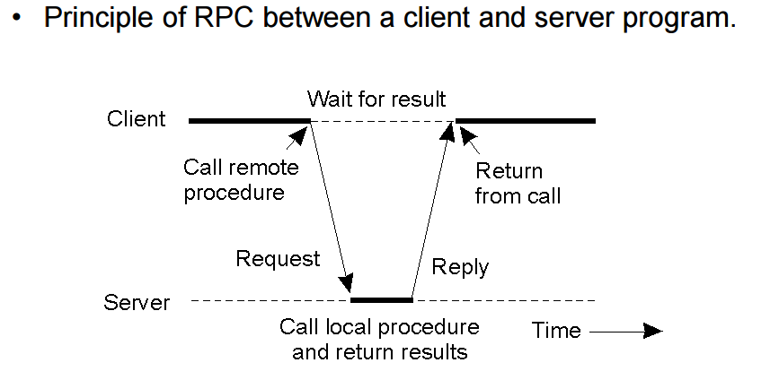
RPC

Slide 12
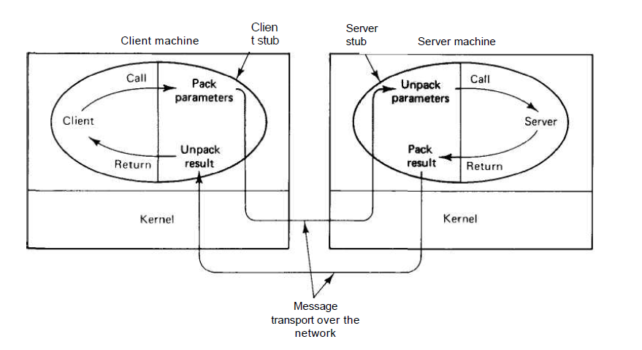
Remote Procedure Call : Model
VESIT: Nupur

Slide 13
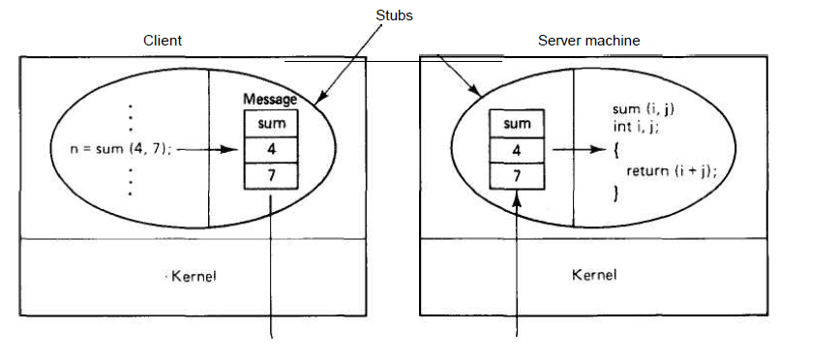
Parameter Passing :RPC
VESIT: Nupur

Slide 14
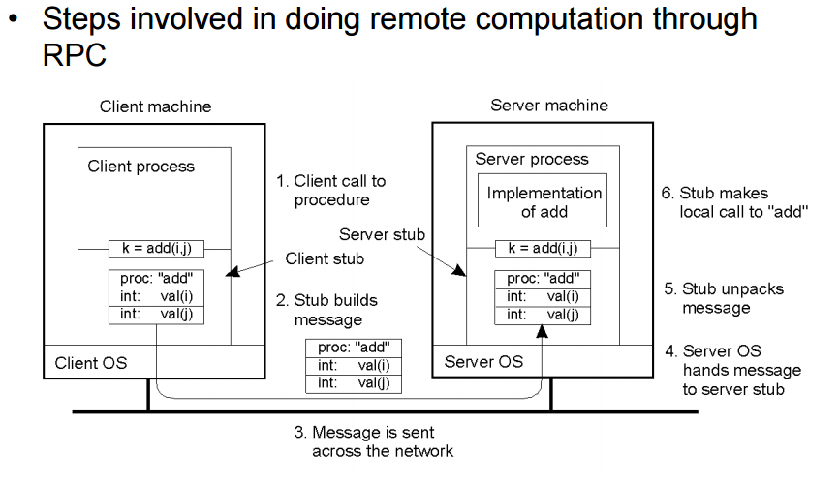
Marshalling Value parameter

Slide 15
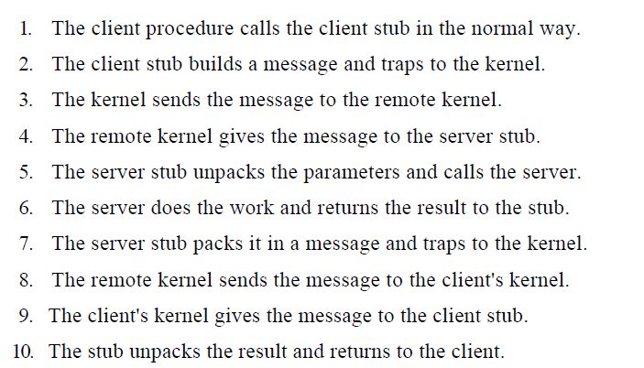
Remote Procedure Call
VESIT: Nupur

Slide 16
Outline of presentation
Message Passing : IPC
OSI Model and Middleware
RPC
RMI
Message Communication Models
Group Communication
MOM
Stream Oriented Communication

Slide 17
Message Passing : RPC
Message Id | Type | Client Id | RPC Id. |  |  | Arguments
 |  |  | Procedure No. | Version | Program no.
RPC Protocol Violation
Service not Accepted
Version not Accepted
Could not Decode Arguments
Exception while execution (divide by zero)
Reply (error/result)

Slide 18
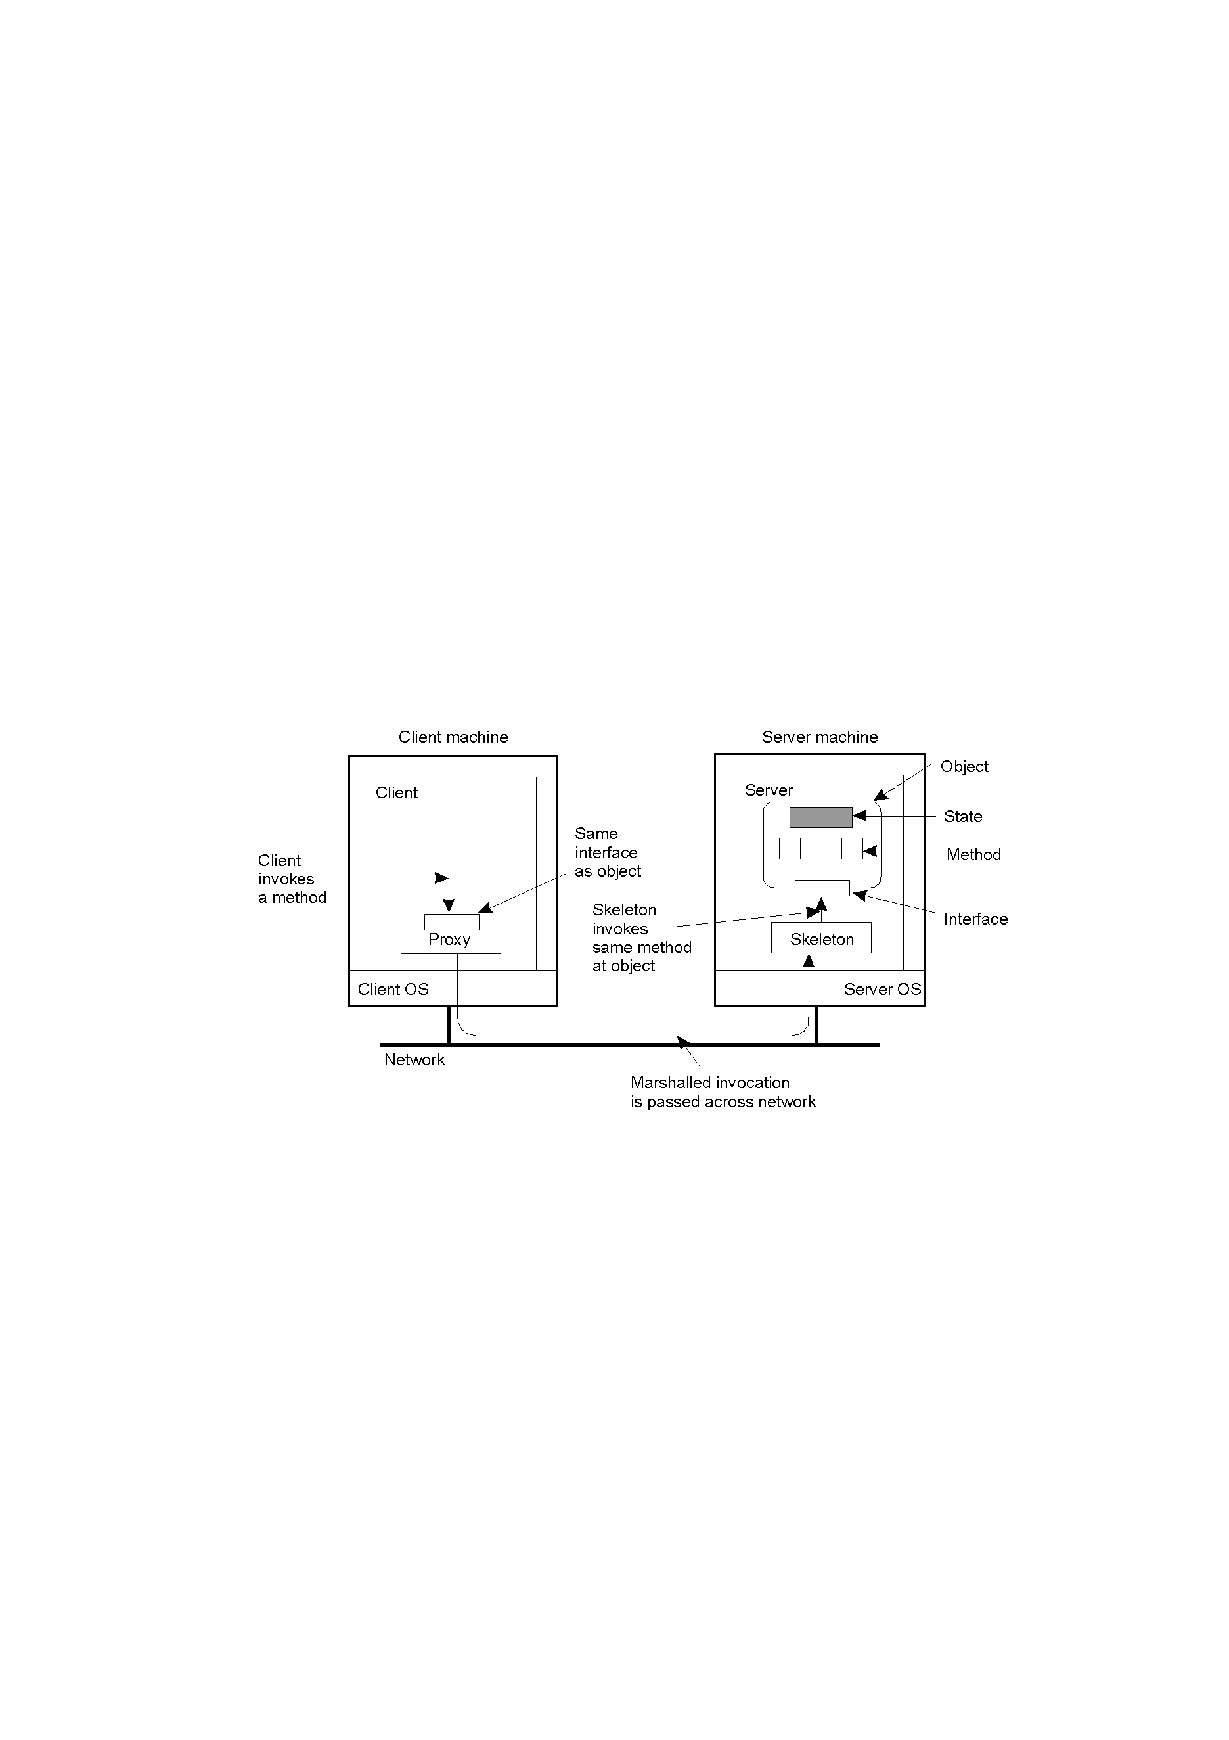
RMI : The Object Model
VESIT: Nupur

Slide 19
Steps : Building the Application
Server Creates Remote Object.
Server Registers Remote Object.
Client requests object from Registry.
Registry returns remote reference
(and stub gets created).
Client invokes stub method.
Stub talks to skeleton.
Skeleton invokes remote object method.
VESIT: Nupur

Slide 20
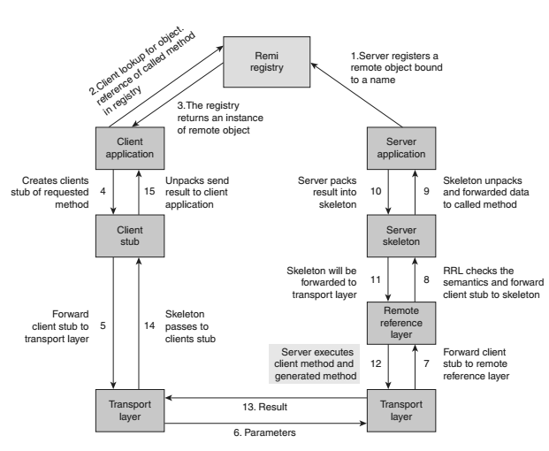

Slide 21
Stub Generation : IDL
An interface description language (or alternatively, interface definition language), or IDL for short, is a specification language used to describe a software component's interface.
IDLs describe an interface in a language-independent way, enabling communication between software components that do not share a language
VESIT: Nupur

Slide 22
JAVA RMI :
In RMI, a common remote interface is the minimum amount of information that must be shared in advance between “client” and “server” machines.
A remote interface is a normal Java interface, which must extend the marker interface java.rmi.Remote.
  Corollaries: because the visible parts of a remote object are defined through a Java interface, constructors, static methods and non-constant fields are not remotely accessible (because Java interfaces can’t contain such things).
All methods in a remote interface must be declared to throw the java.rmi.RemoteException exception.(to deal with unexpected network failures)
VESIT: Nupur

Slide 23
The Calculator interface
public interface Calculator
extends java.rmi.Remote
{
public long add(long a, long b) throws java.rmi.RemoteException;
public long sub(long a, long b) throws
java.rmi.RemoteException;
}
VESIT: Nupur

Slide 24
The Remote Object
A remote object is an instance of a class that implements a remote interface.
Most often this class also extends the library class java.rmi.server.UnicastRemoteObject. This class includes a constructor that exports the object to the RMI system when it is created, thus making the object visible to the outside world.
your remote object classes just have to extend it
A fairly common convention is to name the class of the remote object after the name of the remote interface it implements, but append “Impl” to the end.
VESIT: Nupur

Slide 25
The Interface Implementation
public class CalculatorImpl extends java.rmi.server.UnicastRemoteObject implements Calculator
{
public CalculatorImpl() throws java.rmi.RemoteException
{ super(); }
public long add(long a, long b) throws java.rmi.RemoteException { return a + b; }
public long sub(long a, long b) throws java.rmi.RemoteException { return a - b; }
}
VESIT: Nupur

Slide 26
The Stub and Skeleton Generation.
>rmic CalculatorImpl
  CalculatorImpl_skel.class
  CalculatorImpl_stub.class
  javac
VESIT: Nupur

Slide 27
The Server Program.
import java.rmi.Naming;
public class CalculatorServer
{
public CalculatorServer() {
try
{
Calculator c = new CalculatorImpl();
Naming.rebind("rmi://localhost:1099/CalculatorService", c);
}
catch (Exception e) { System.out.println("Trouble: " + e);}
}
public static void main(String args[])
{ new CalculatorServer(); }
}
VESIT: Nupur

Slide 28
Anatomy of the Server
This program does two things:
  It creates a remote object with local name server.
  It publishes a remote reference to that object with external name “CalculatorService”.
The call to Naming.rebind() places a reference to server in an RMI registry running on the local host (i.e., the host where the calculatorServer program is running).
Client programs can obtain a reference to the remote object by looking it up in this registry.
VESIT: Nupur

Slide 29
The Client Program
public class CalculatorClient
{
public static void main(String[] args)
{
try
{ Calculator c = (Calculator)Naming.lookup("rmi://localhost/CalculatorService");
System.out.println( c.sub(4, 3) );
System.out.println( c.add(4, 5) );
} catch (/*some exception*/) {/*___*/}
}
}
VESIT: Nupur

Slide 30
Server Management
Server States
  Stateful
  Stateless
Server Creation Semantics
  Instance - Per - Call
  Instance - Per – Session
  Persistent Servers

Slide 31
Parameter Passing
Call – by – value
Call by Reference
Call Semantics
May- be
Last-one call
Last – of –many
At – least once
Exactly once

Slide 32
Communication Protocols
The Request Protocol (may-be)
The Request/Reply Protocol (at-least once)
The Request/Reply/Acknowledge Protocol
RPC involving Long-duration calls /gaps
  Periodic probing of the server by the client
  (server crash/link failure)
  Periodic generation of an acknowledgement by the server
RPC involving arguments and or results that are large to fit in a single datagram packet.
Multiple RPC (multiple ack.) / Multidatagram (single ack)

Slide 33
Outline of presentation
Message Passing : IPC
OSI Model and Middleware
RPC : Revisited
RMI
Message Communication Models
Group Communication
MOM
Stream Oriented Communication

Slide 34
Special types of RPC
Callback RPC
  Provide the server with the client handle
  Making the client process wait for the callback RPC
  Handling Call back deadlocks
Broadcast RPC
Batch Mode RPC (reduced overhead)
  Predetermined interval
  Predetermined no. of requests
  Amount of batched data exceeds the buffer size

Slide 35
RPC in Heterogeneous Environments
Data Representation
Transport Protocol
Control Protocol

Slide 36
Lightweight RPC
Cross-Domain
Cross-Machine
Simple Control Transfer: client thread and server threads are not bound to their domains.
Simple Data Transfer: Shared Argument stack
Simple Stubs: blur the boundaries
Design for Concurrency: lower call latency, minimize shared data structure will avoid locks.

Slide 37
Optimizations for better Performance
Concurrent Access to Multiple Server
Serving Multiple Requests simultaneously
Reducing Per-Call Workload of Servers
Reply Caching of Idempotent Remote Procedures
Proper Selection of Timeout Values
Proper Design of RPC Protocol Specification

Slide 38
Outline of presentation
Message Passing : IPC
OSI Model and Middleware
RPC
RMI
Message Communication Models
Group Communication
MOM
Stream Oriented Communication

Slide 39
Synchronisation
Blocking : Synchronous
  Polling
  Interrupt
Non blocking: Asynchronous
Buffering
Buffered : Persistent
  Single message , finite bound, multiple-message buffers (unsuccesful /flow controlled)
Non Buffered : Non persistent / transient

Slide 40
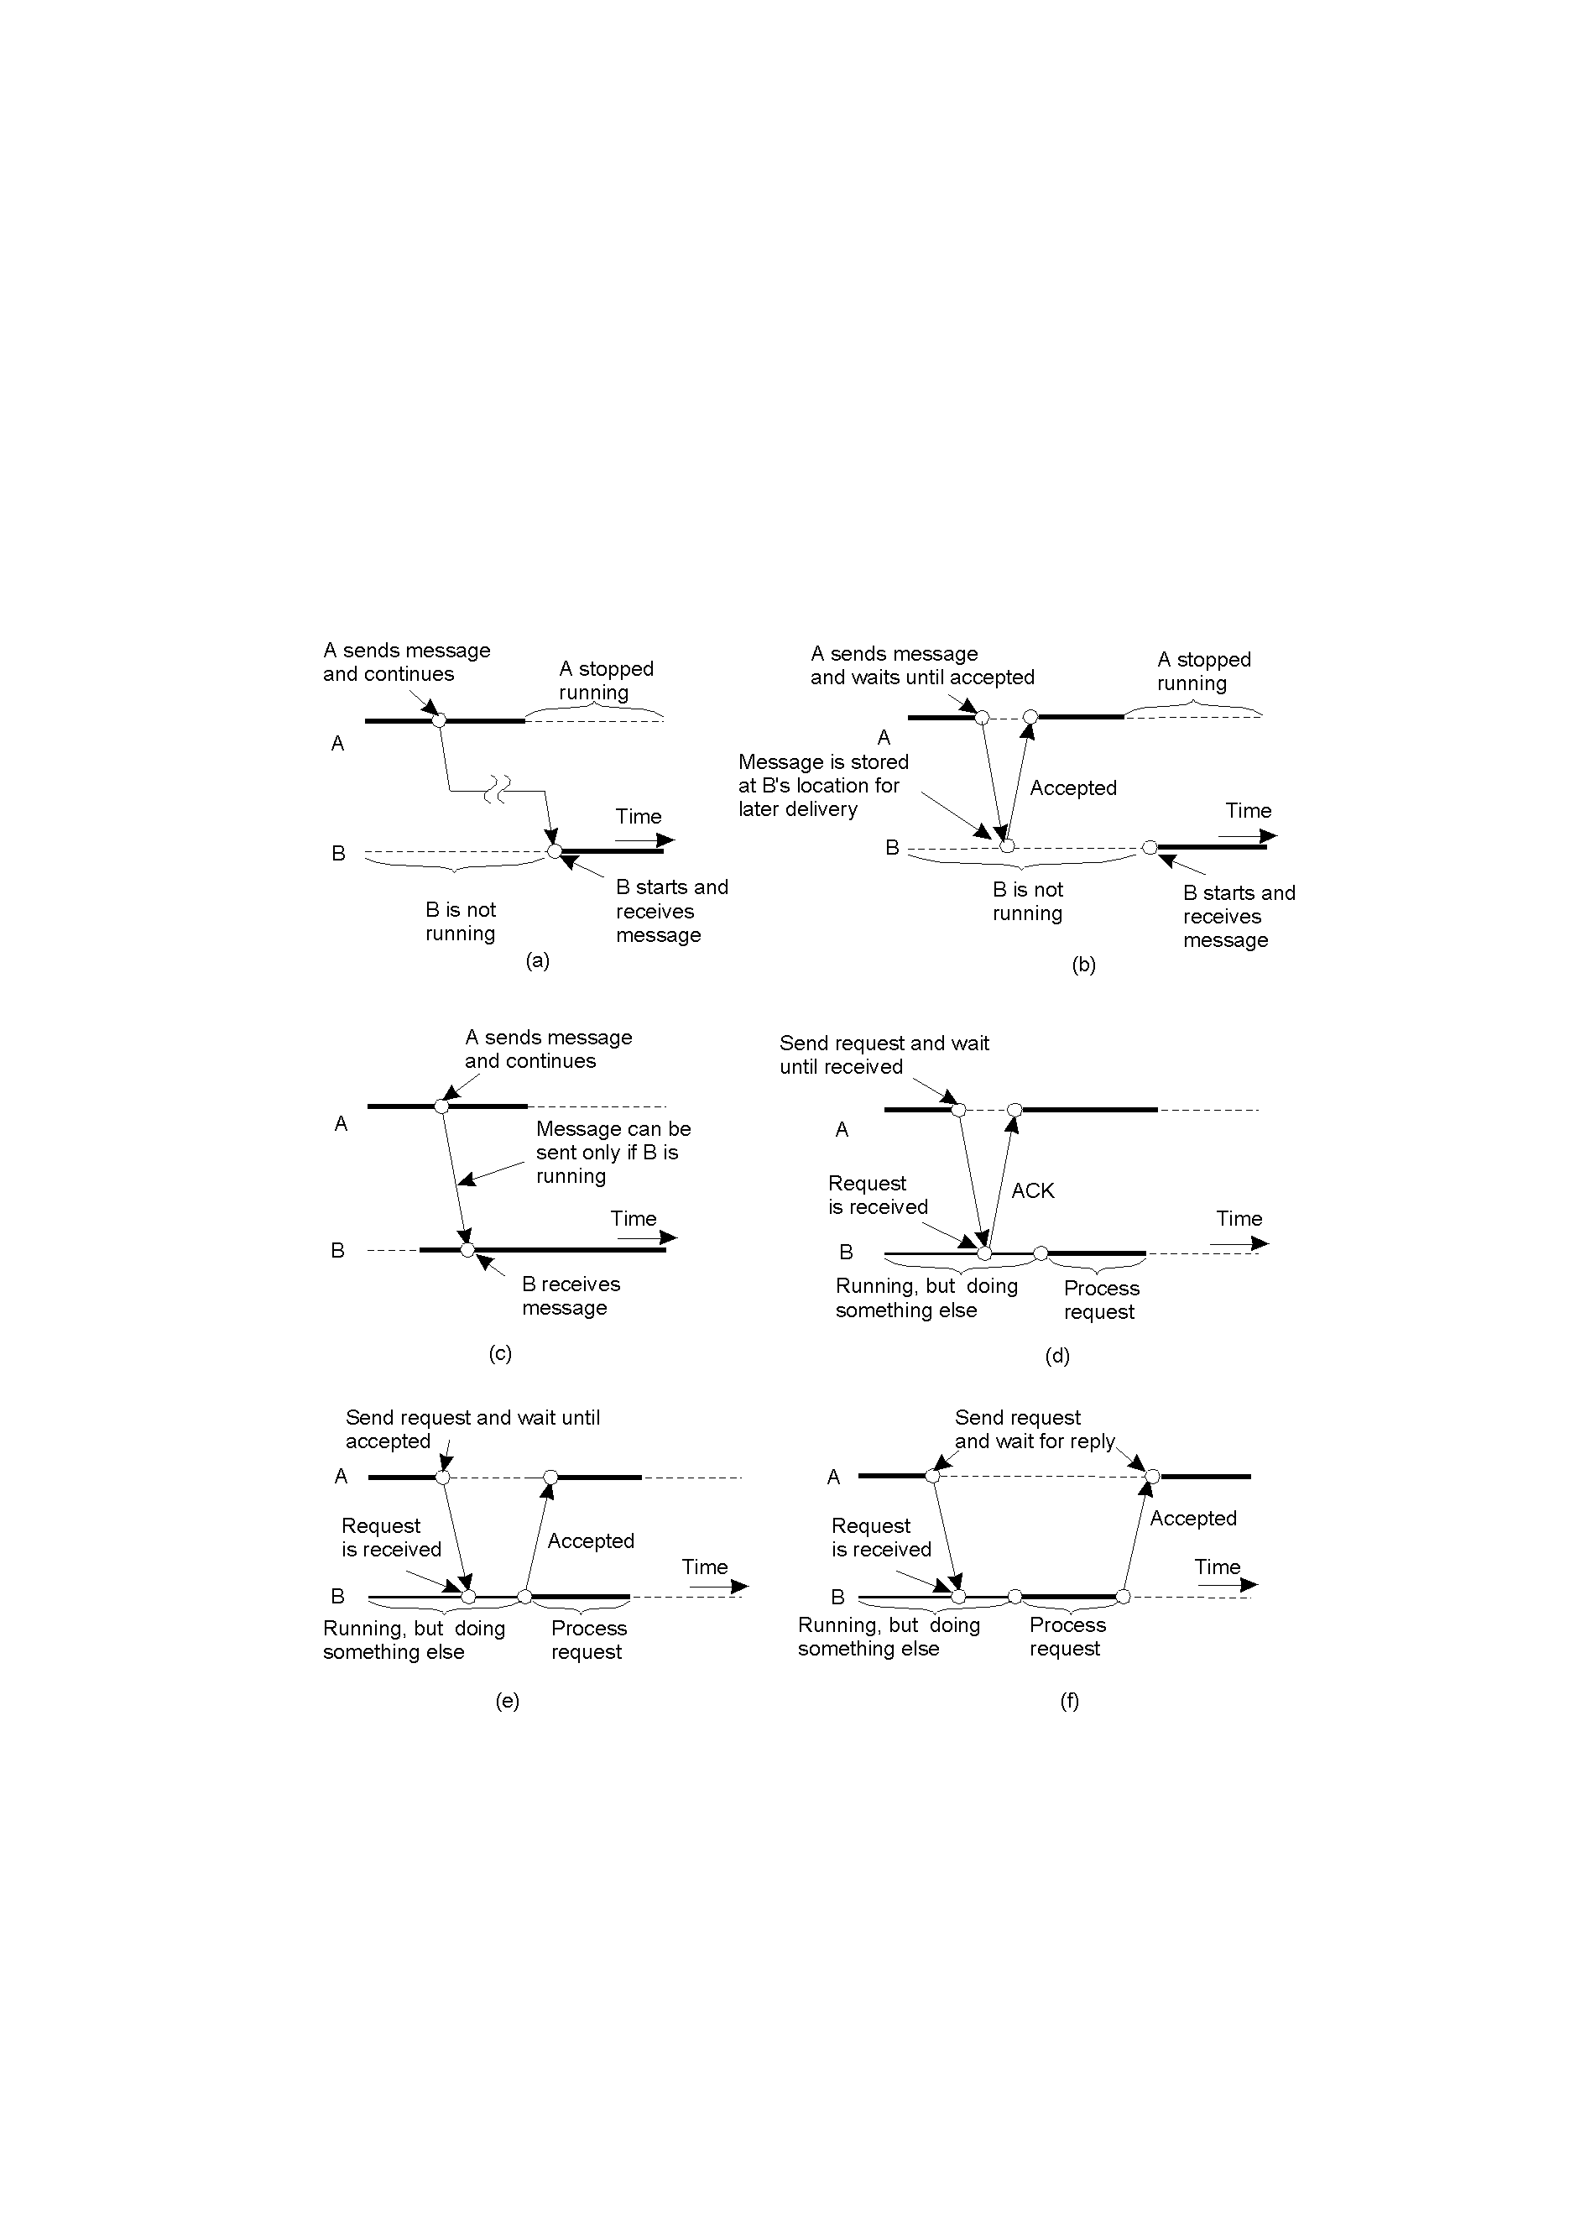
Persistence and Synchronicity in Communication (3)
2-22.1
Persistent asynchronous communication
Persistent synchronous communication

Slide 41
Persistence and Synchronicity in Communication (4)
2-22.2
TCP
Transient asynchronous communication
Receipt-based transient synchronous communication

Slide 42
Persistence and Synchronicity in Communication (5)
RPC/RMI
Delivery-based transient synchronous communication at message delivery
Response-based transient synchronous communication

Slide 43
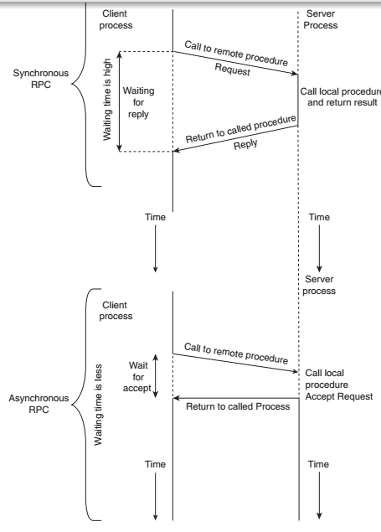
RPC Message Passing Model
Synchronous RPC.
Asynchronous RPC.

Slide 44
Outline of presentation
Message Passing : IPC
OSI Model and Middleware
RPC
RMI
Message Communication Models
Group Communication
MOM
Stream Oriented Communication

Slide 45
Group Communication
One to many Communication
  Multi cast
    Closed group/Open group
    Group server : managing group activity (poor reliability, scalability)
    Group addressing : A two level naming scheme
    Message Delivery to Receiver Process : via mapping of high level name to IP address
    Buffered and un-buffered : Asynchronous
    Send-to-All and Bulletin-Board Semantics :
    - A copy of the message.
    -The message is sent to a channel (bulletin board) (receive access right)
    -Relevance of a message to a particular receiver may depend on the receiver’s state.
    -Message received after a certain time after transmission may no longer be relevant (their value may depend on the sender’s state)
    Flexible Reliability in multicast communication
    -0-Reliable/1-Reliable/m-out-of-n-reliable/All reliable
    Atomic Multicast

Slide 46
Group Communication
Many to One Communication
Many to Many Communication
  Ordered Massage delivery through message sequencing
    Absolute Ordering
    Consistent Ordering
    Causal Ordering

Slide 47
Message Ordering
R1 and R2 receive m1 and m2 in a different order!
Some message ordering required
  Absolute ordering
  Consistent/total ordering
  Causal ordering
S1
R1
R2
S2
m2
m1
m1
m2

Slide 48
Absolute Ordering
Rule:Global Timestamp
  Mi must be delivered before mj if Ti < Tj
Implementation:
  A clock synchronized among machines
  A sliding time window used to commit message delivery whose timestamp is in this window.
Example:
  Distributed simulation
Drawback
  Too strict constraint
  No absolute synchronized clock
  No guarantee to catch all tardy messages
Ti < Tj
Ti
mi
Tj
mi
mj
mj

Slide 49
Consistent/Total Ordering
Rule:
  Messages received in the same order (regardless of their timestamp).
Implementation:
  A message sent to a sequencer, assigned a sequence number, and finally multicast to receivers
  A message retrieved in incremental order at a receiver
Example:
  Replicated database updates
Drawback:
  A centralized algorithm
Ti < Tj
Ti
mj
Tj
mj
mi
mi

Slide 50
Consistent Ordering
Centralized Sequencer
Distributed Algorithm: ABCAST Algo:
Sender assigns a temp. seq. no. and sends it to all grp members.
(tmp seq no> prv. Seq. used by sender
Each mem (i) calculates = max (F(max), P (max) ) + 1 + i/N; sends back to sender
F(max) largest final seq no agreed upon so far, P(max) is largest proposed seq no., N is the total no of participants
The sender then selects the largest and sends to all receivers as final “commit”.
On recv commit message, each member attaches the final seq no to the message.

Slide 51
Total Ordering Using A Sequencer
Sender assigns a temporary seq no. and sends to all
On receiving the message, each member calculates max,
When sender receives from all, it selects largest and assigns that seq no to the message.
On receiving this commit message the receiver then attaches this final seq to the message
21
32
Ti
Tj
R1= 23; max(20,21)+1+1/2
Mj
R2= 35; max(33,21)+1+2/2
mj
Mi 21
Mi 21
Max(Fmax, Pmax)+1+i/N

Slide 52
Causal Ordering
From R2’s view point m1 →m3, and event m3 is causally dependent on m1
So order of m1 and m3 should be preserved in at all receiver
Where as order of m2 does not matter
S1
R1
R2
R3
S2
m1
m2
m1
m2
m3
m1
m3

Slide 53
Causality : Causal Ordering
Pi[i] is the number of events that have occurred so far at P_{i}
Pi[j] = k then Pi knows that k events have occurred at Pj
(When Pi sends message m, it sends along its current vector as a timestamp )
Also a message for m tells the receiver how many events, in other processes have preceded m)
So now Pj[j]=m reflects the number of messages that Pj must receive to have atleast seen
the same messages that preceded sending of m. Hereafter, entry Pi[j] is incremented by 1.
Conditions:
1.S[i] = R[i]+1
This condition ensures that the receiver has not missed any message from sender. (two message from the same sender are expected to be causally dependent)
2. S[j] <= R[j] for all j=i
This ensures that the sender has not received any message that the receiver has not received as yet.. (so this ensures that sender’s message is not causally related to a message missed by the receiver.
Vector of Process A
Vector of Process B
Vector of Process C
Vector of Process D
3 | 2 | 5 | 1
3 | 2 | 5 | 1
2 | 2 | 5 | 1
3 | 2 | 4 | 1
New MessageA
4 | 2 | 5 | 1 | Message Data
A[1]=C[1]+1
A[3]<=D[3]

Slide 54
Consistent Ordering
Absolute Ordering
Global Timestamp
Centralized Sequencer
Distributed Algorithm: ABCAST Algo:
Sender assigns a temp. seq. no. and sends it to all grp members.
(tmp seq no> prv. Seq. used by sender
Each mem (i) calculates = max (F(max), P (max) ) + 1 + i/N; sends back to sender
F(max) largest final seq no agreed upon so far, P(max) is largest proposed seq no., N is the total no of participants
The sender then selects the largest and sends to all receivers as final “commit”.
On recv commit message, each member attaches the final seq no to the message.

Slide 55
Outline of presentation
Message Passing : IPC
OSI Model and Middleware
RPC
RMI
Message Communication Models
Group Communication
MOM
Stream Oriented Communication

Slide 56
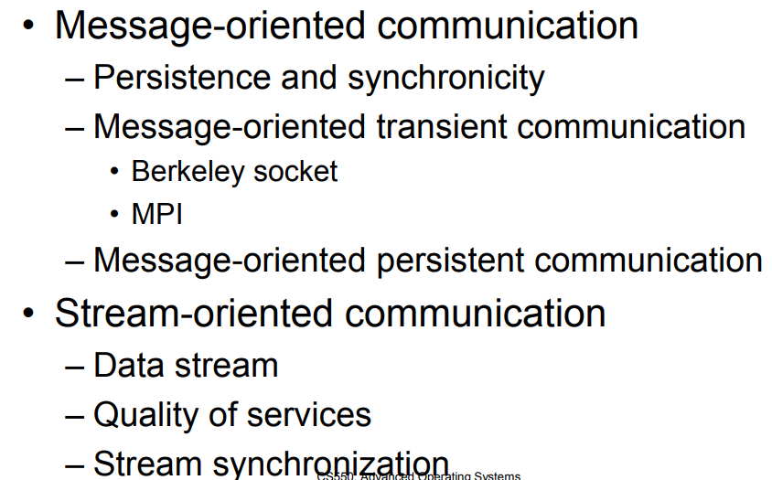
MOM Vs SOM

Slide 57
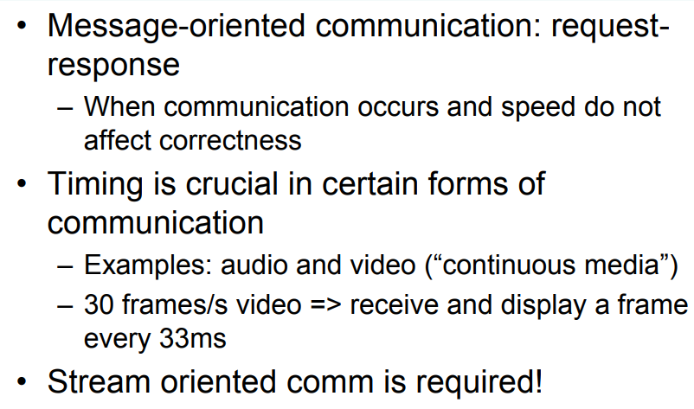

Slide 58
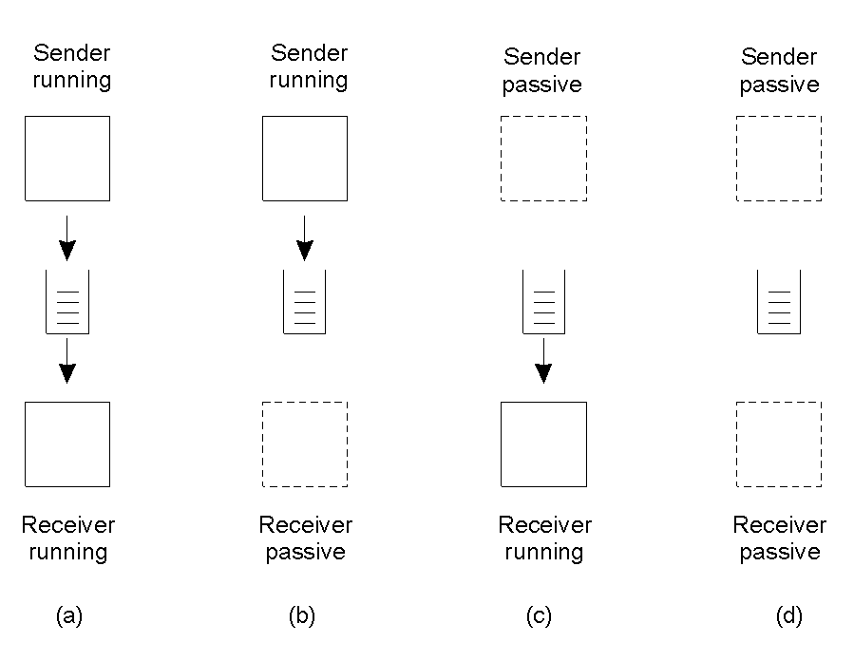
Message-Queuing Model (Message Oriented Model)
(MOM)
2-26
Four combinations for loosely-coupled communications using queues.

Slide 59
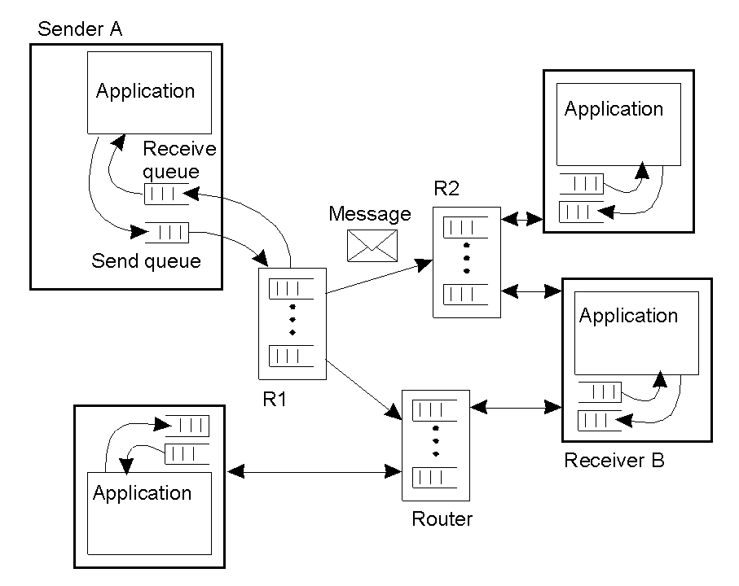
General Architecture of a Message-Queuing System (2)
Queue manager
2-29
The general organization of a message-queuing system with routers.

Slide 60
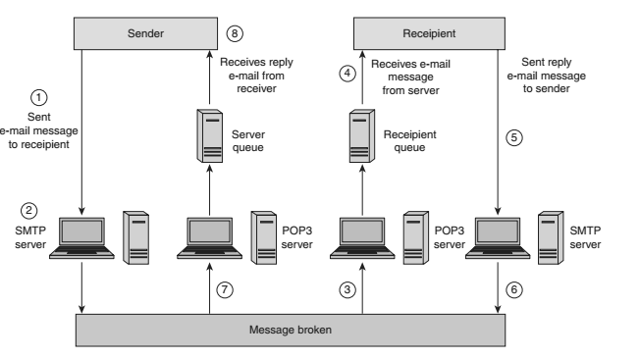

Slide 61
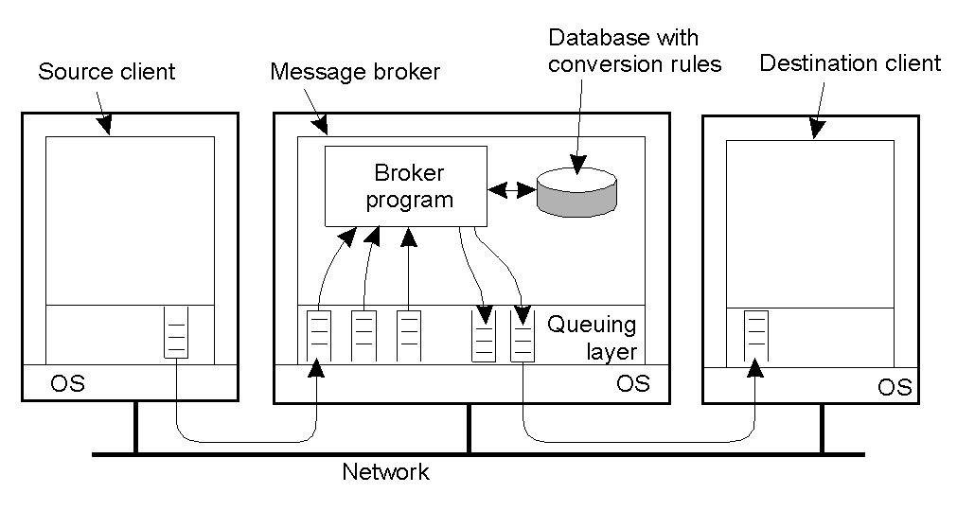
Message Brokers
2-30
The general organization of a message broker in a message-queuing system.

Slide 62
Outline of presentation
Message Passing : IPC
OSI Model and Middleware
RPC
RMI
Message Communication Models
Group Communication
MOM
Stream Oriented Communication

Slide 63
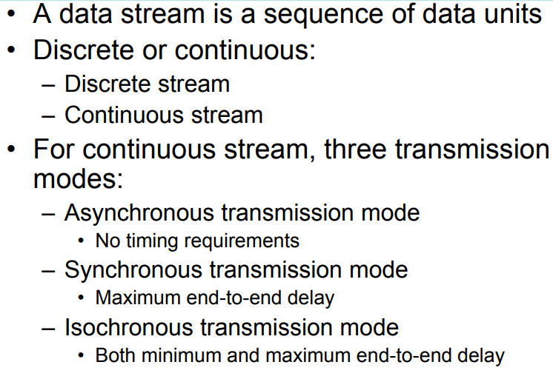
Data Stream (1)

Slide 64
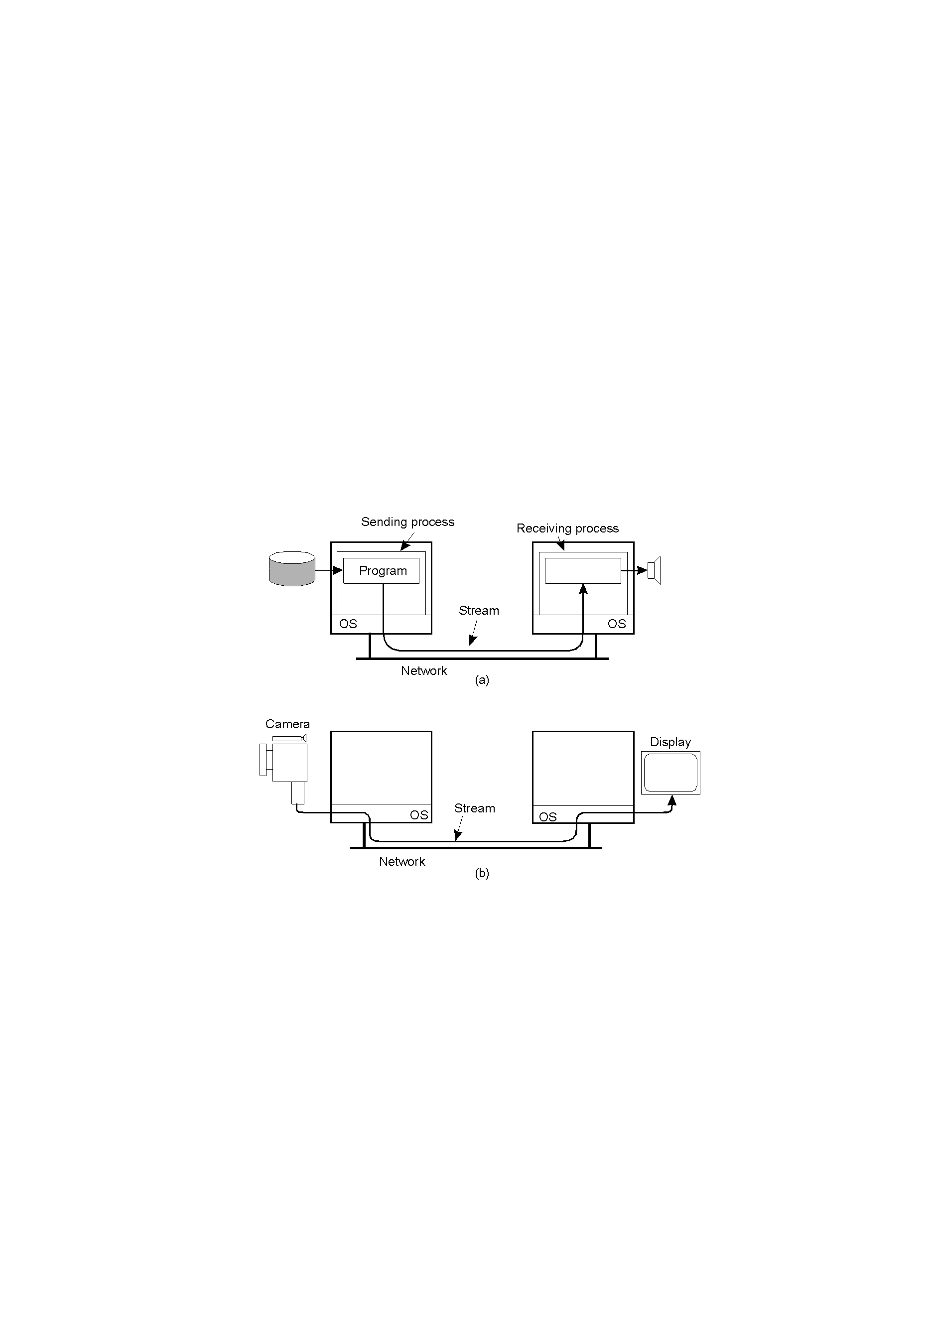
Data Stream (1)
Setting up a stream between two processes across a network.

Slide 65
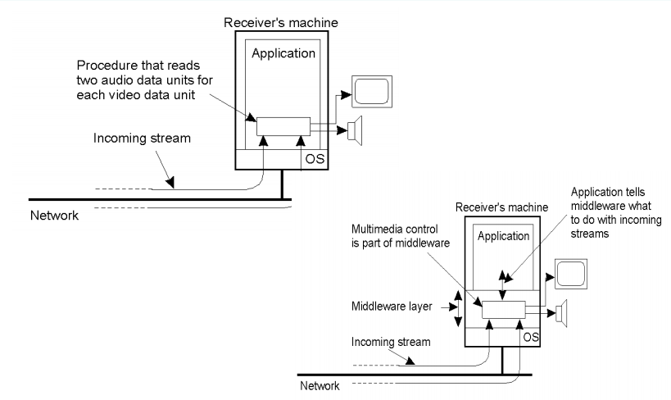
Data Stream (1)

Slide 66
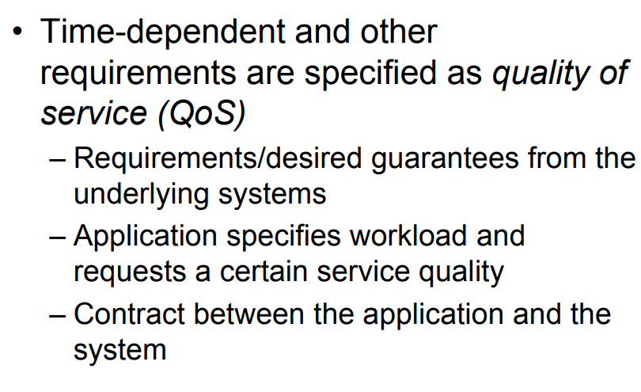

Slide 67
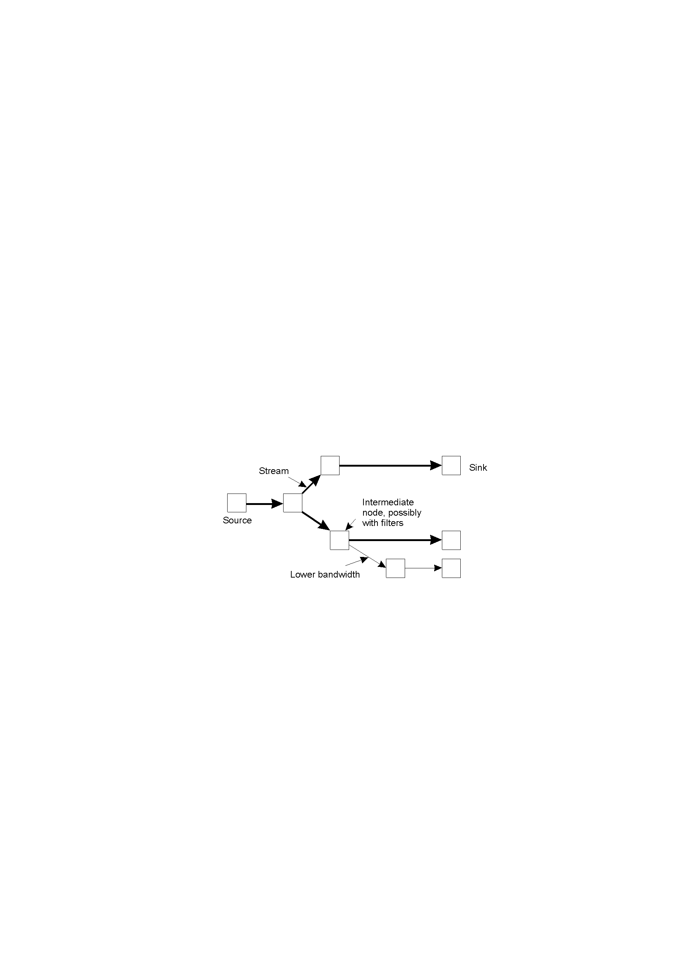
Data Stream
An example of multicasting a stream to several receivers.

Slide 68
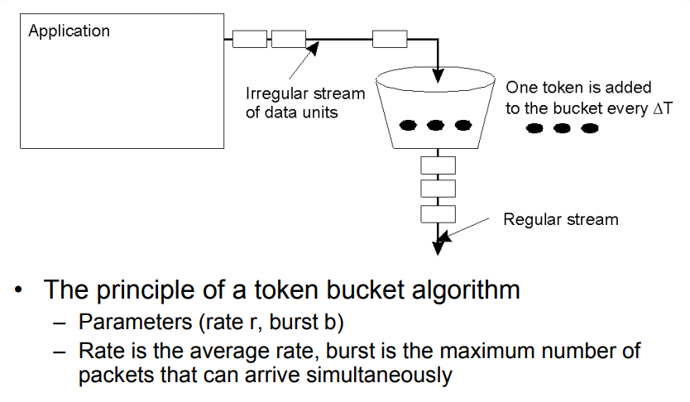
Token Bucket

Slide 69
Specifying QoS (1)
Characteristics of the Input | Service Required
maximum data unit size (bytes) Token bucket rate (bytes/sec) Toke bucket size (bytes) Maximum transmission rate (bytes/sec) | Loss sensitivity (bytes) Loss interval (μsec) Burst loss sensitivity (data units) Minimum delay noticed (μsec) Maximum delay variation (μsec) Quality of guarantee
A flow specification.

Slide 70
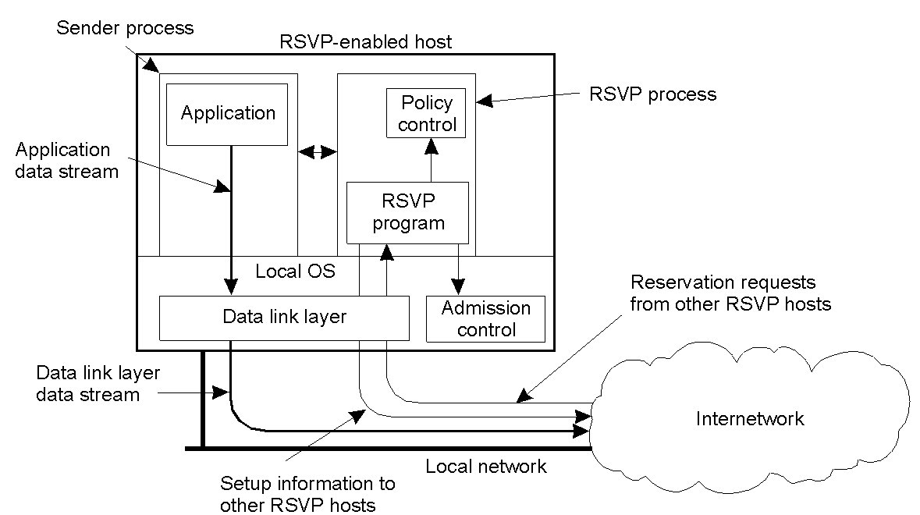
Setting Up a Stream
The basic organization of RSVP for resource reservation in a distributed system.

Slide 71
Assignments:
Detailed Note of Types of RPC, Call back and Lightweight RPC

Slide 72
Quiz
2. The extended RPC models are
  (a) Doors and asynchronous RPC
  (b) Object RPC and asynchronous RPC
  (c) DCE and synchronous RPC
  (d) Synchronous and asynchronous RPC
3. The two popular remote object invocation models are
  (a) RPC and RMI
  (b) CORBA and RMI
  (c) MOM and RPC
  (d) MPI and MOM

Slide 73
Quiz
4. How many layers are there in RMI architecture?
  (a) Five
  (b) Four
  (c) Three
  (d) Six
5. The MPI and sockets are used in ______________
(a) Message-oriented transient communication
(b) Message-oriented persistent communication
(c) Message-oriented synchronous communication
(d) Message-oriented asynchronous communication
6. Which communication model uses the queuing model?
(a) RPC
(b) RMI
(c) MOM
(d) MPI

